Slide 1


Slide 2
Employee Management System

Slide 3
INTRODUCTION
Employee Management System is based on a concept to store and generate all the records of the employees. This program is considered as a simple database of employees in an office, an organization where the user can store employees record easily as it is not time-consuming.

Slide 4
Purpose
Employee Management System is a distributed application, developed to maintain the details of employees working in any organization. The EMS has been developed to override the problems prevailing in the practicing manual system. It maintains the information about the personal and official details of the employees.

Slide 5
Features
Add Record
Search Record
Edit Record
Modify Record
Display Record
Salary Slip Generation
Display Salary Record

Slide 6
Advantages
Provide computerized system for maintaining records.
More efficient & reliable.
Less time consuming and easy to use.
Huge data storage with less computer memory.
Avoid Human errors & efforts for Maintaining daily data.
Avoid Data manipulations.
Also avoids Data inconsistency & redundancy.

Slide 7
C++ Concepts
The concepts that we have used in this project are
Queues
Linked List
File Handling
Classes
Structures
Conditional statements
Loops
Constructors

Slide 8
Language and IDE
The programming language we have used in this system is
C++
The software used for this system is
Dev C++
Visual Studio

Slide 9
Outputs

Slide 10
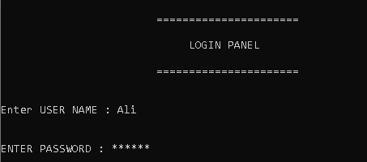
Login Panel

Slide 11
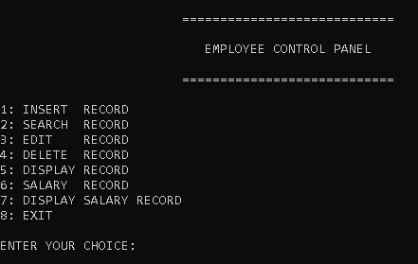
Control Panel

Slide 12
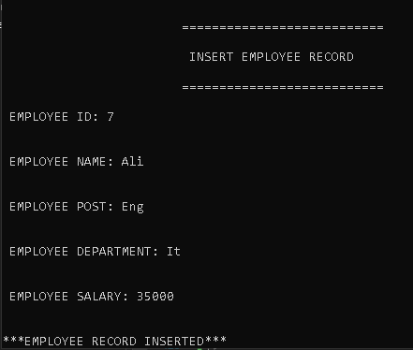
Insert Record

Slide 13
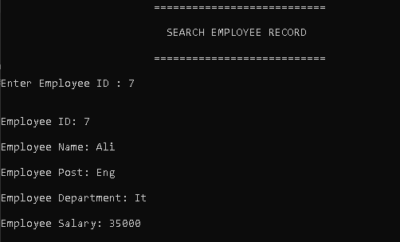
Search Record

Slide 14
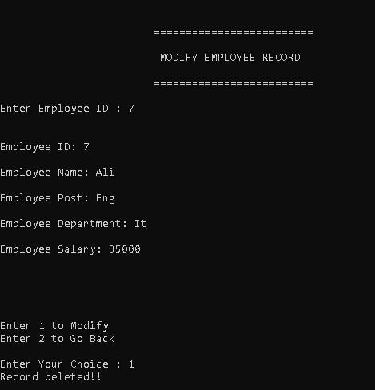
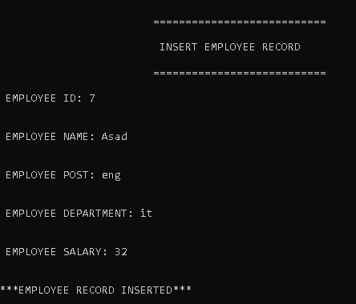
Edit Record

Slide 15
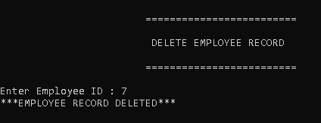
Delete Record

Slide 16
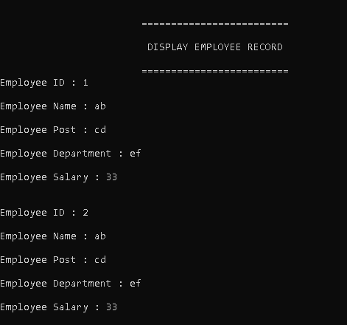
Display Record

Slide 17
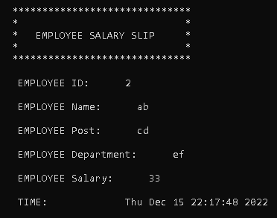
Salary Slip Generation

Slide 18
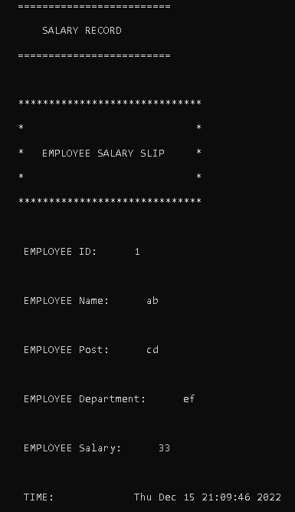
Display Salary Record

Slide 19
THANKYOU!
Any Questions?

